Slide 1

HIGH FREQUENCY LONGITUDINAL SURVEYS OF THINGS: Real Time Energy Monitoring IN Tajikistan
Joao Pedro Azevedo and William H. Seitz
In collaboration with Dana Rysankova, Elisa Portale, and Gouthami Padam (esmap global team) and Arthur Kochnakyan and Takhmina Mukhamedova (Tajikistan energy team)
Leveraging Open, Big and Geospatial Data Innovations within EEX Operations
March 2017

Slide 2
SMS data preprocessing workflow

Slide 3
Data preprocessing objectives
Sanitize time related variables
Infer power status (1: power on, 0: power failure) from events
Regularize data in order to have power status for every time unit (e.g., hour)
Identify time instants with missing power status (missing data)
Train a machine learning model to impute missing data
Impute missing data

Slide 4
Missing data
Rectangular dataset
t1-t< threshold
(t1, event_1)
Time slots (hrs.) with no data

Slide 5
How good can we predict ‘power_state’ ?
Test the following 5 models
Tree based models
Random forest (RF)
Extreme random trees(ETC)
Gradient boosted trees(GBM)
Logistic regression (LR)
K-nearest neighbor (KNN)
Baseline models:
Random classifier
Majority classifier
Vs.
t1-t< threshold
(t1, event_1)
Using the following metrics
Accuracy
Precision
Recall

Slide 6
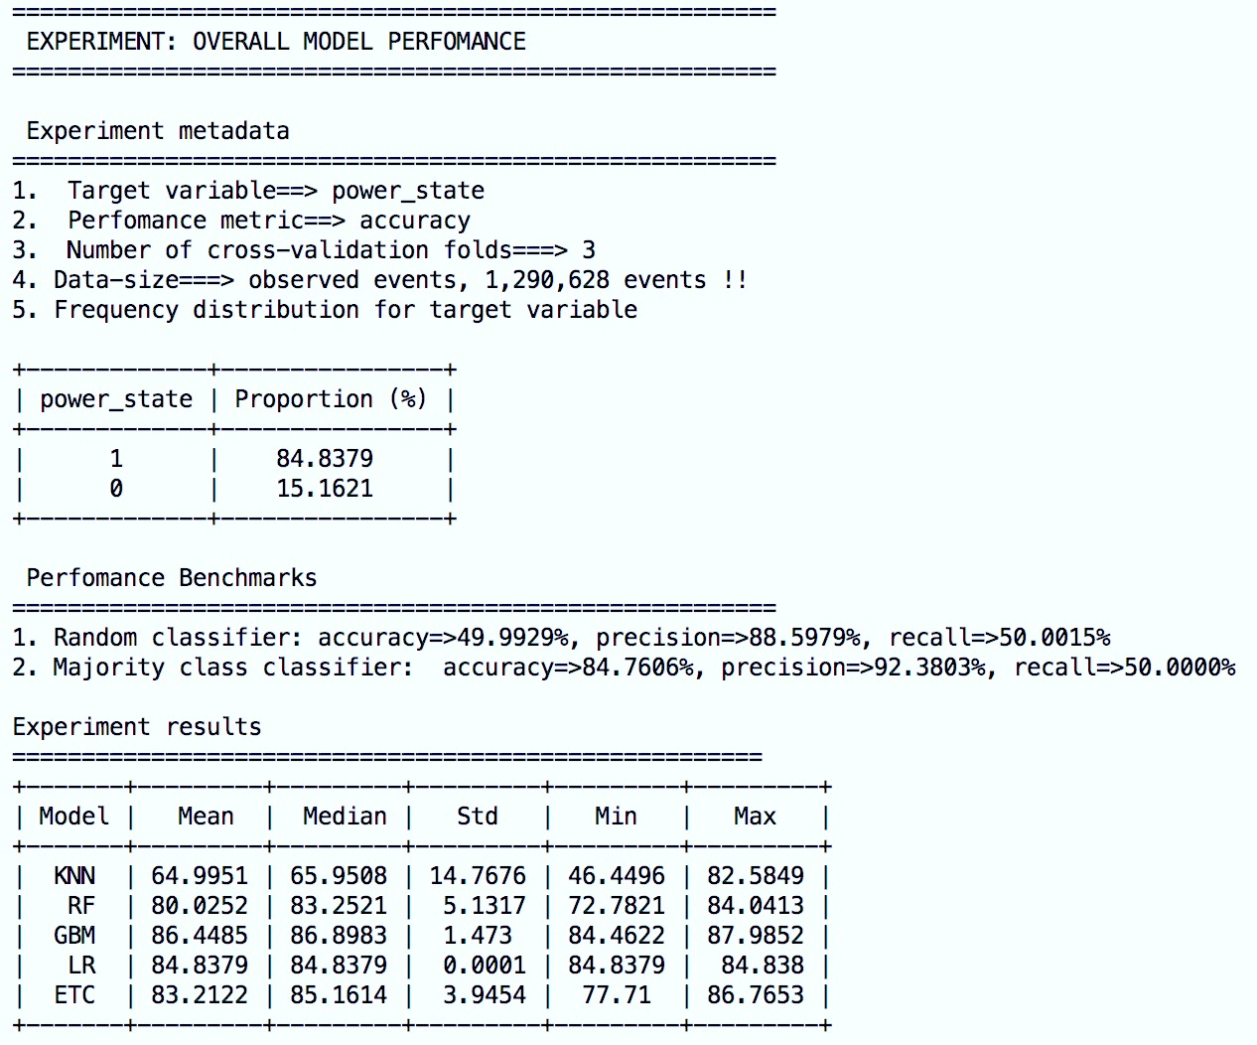
Experiment results-Model accuracy
Using median as a single measure:
GBM and ETC perfomance better than both of the baseline models
t1-t< threshold
(t1, event_1)

Slide 7
Experiment results-Precision
Using median as a single measure:
GBM, RF and ETC performance better than both of the baseline models
t1-t< threshold
(t1, event_1)

Slide 8
Alternatively, we could model event_type (exact message coming from monitoring device)
Time slots (hrs.) with no data

Slide 9
Which is easier to predict: event_type or power_state?
Accuracy-power_state
Accuracy-event_type
t1-t< threshold
(t1, event_1)
Better accuracy (w.r.t. baseline values) when using power_state

Slide 10
Why poor predictions when using event_type?
Confusion matrix based on best preforming model: GBM
t1-t< threshold
(t1, event_1)
Pback seem to be the hardest event to predict as it has lowest accuracy.

Slide 11
More results
Predictability dependent on TIME (SEASONALITY) and location
t1-t< threshold
(t1, event_1)

Slide 12
More results
Predictability dependent on Time (seasonality) and LOCATION
(t1, event_1)
All models perform badly for this region

Slide 13
So how do we impute missing data?
Once best performing model is selected, just train on all data and predict missing data
OTHER caveats
How often to update model parameters
Whether to have different models for different regions
(t1, event_1)
Work in progress

